Slide 1

Identifying Health Condition Of Leaf Using CNN
by
K.Karthik
Roll No. 194G5A0503
N. Keerthi
Roll No. 184G1A0530
B. Drakshayini
Roll No. 184G1A0516
G. Naveen Kumar
Roll No. 184G1A0552
Under the guidance of
Mr. P. Veera Prakash _{M.Tech., (Ph.D)}
Assistant Professor
Department of Computer Science and Engineering
Srinivasa Ramanujan Institute of Technology
(Affiliated to JNTUA & Approved by AICTE) (Accredited by NAAC with ‘A’ Grade & Accredited by NBA (EEE, ECE & CSE)
Rotarypuram Village, B K Samudram Mandal, Ananthapuramu – 515701.
2021 - 2022

Slide 2
Abstract
Identification of the plant diseases is the key to preventing the loses in the yield and quantity of the agricultural product. The studies of the plant diseases mean the studies of visually observable patterns seen on the plant. Health Monitoring and disease detection on plant is very critical for sustainable agriculture.
It is very difficult to monitor the plant diseases manually. It requires tremendous amount of work, expertise in the plant diseases, and also require the excessive processing time. Hence, Image Processing is used for the detection of plant diseases. Disease detection involves the steps like Image Acquisition, Image Pre-Processing, Image Segmentation, Feature Extraction and Classification into healthy or diseased leaves.

Slide 3

Contents
Introduction
Existing System
Proposed System
Literature Survey
Problem Definition
Planning
Requirements
Design
Implementation
Sample Code
Screenshots
Conclusion
References

Slide 4
Introduction
The diseases in the leaves greatly reduces the yield and quality. It is vital to
identify the diseases at the early stage of infection for preventing and managing plant diseases. The main reasons for the plant diseases are the
infections such as insect pests, bacteria, fungi, and viruses. If they are not
detected at an early stage, then the diseases may spread through out the plant
body or from one plant to another plant. So, this project mainly focuses on
detection of health condition based on Convolutional Neural Networks.

Slide 5
Literature Survey
As our project has to prefer journals and published papers and also we have usedsome
websites to understand the problem.
[Mr.V Suresh, D Gopinath, M Hemavarthini, K Jayanthan, Mohana Krishnan -1]: This paper can be effectively used by farmers thereby increasing the yield rather than visiting the expert and getting their advice. An application built for the identification of disease affected plants and healthy plants is done and this proposed work is focuses on the accuracy values during the real field conditions, and this work is implemented by having several plant disease images.
[Vagisha Sharma, Amandeep Verma, Neelam Goel – 2] : In this paper, classification techniques that are most widely used for the identification and detection of diseases on plant leaves have been reviewed. It can be concluded that amongst the techniques that have been used in the existing work done, highest accuracy has been achieved with the deep learning concepts that is through the CNN approach.

Slide 6
...Contd
[Dr. L. Malathi 1, P. Yogashree 2, Thamaraiselvi 3]: Convolutional Neural Network models were made to perform plant contamination area and assurance using essential leaves pictures of sound and undesirable plants, through significant learning techniques. Getting ready of the models was performed with the use of an open database of 87,848 pictures, containing 25 one of a kind plants in a ton of 58 specific classes of [plant, disease] mixes, including strong plants. All these are, clearly, generous under the condition that the structure could achieve huge degrees of execution in recognizing and diagnosing express diseases, taking everything into account, conditions (i.e., in the advancement field), and that it could be worked through a legitimate, easy to-use, and simple to utilize compact application for the specific case of wheat plants.

Slide 7
Existing System
From a long time, identifying the diseases in a plant or leaf is done by the experts through their naked eyes based on their knowledge and experience. Finding an expert and contacting them is not only a tedious and time consuming task but also a very long and expensive method.
Therefore, the complete process sometimes takes so much time which would become time taking for the disease to be eradicated and also very tedious incase of large areas.
Many modern techniques are available for plant disease detection, like processing, similarity identification and deep learning based classification techniques better in respect of time saving than the old methods used.

Slide 8
Proposed System
Plants are susceptible to various disease – related disorders and seizures. There are various causes which can be characterized by their effect on plants, disturbances due to environmental conditions such as temperature, humidity, excessive or insufficient food , light and the most common diseases such as bacterial, viral and fungal diseases.
In the proposed system, we use the CNN algorithm to detect disease in plant leaves because with the help of CNN the maximum accuracy can be achieved if the data is good.

Slide 9
Problem Definition
Plant diseases have turned into a dilemma as it can cause significant reduction
in both quality and quantity of agricultural products. Manual detection required
high domain knowledge and is often time consuming. Thus we use automatic
detection system. Automatic detection of plant diseases is an essential research
topic as it may prove benefits in monitoring large fields of crops, and thus
automatically detect the symptoms of diseases as soon as they appear on plant
leaves. The proposed system is a solution for automatic detection and
classification of plant leaves according to their health condition.

Slide 10
Requirements
Hardware Requirements:
Processor: Minimum Intel Core I3
RAM: Minimum 4 GB
Hard Disk: Minimum 250 GB
Operating System: Windows, Linux
Software Requirements:
Programming Language: Python 3.8
Browser: Google Chrome

Slide 11
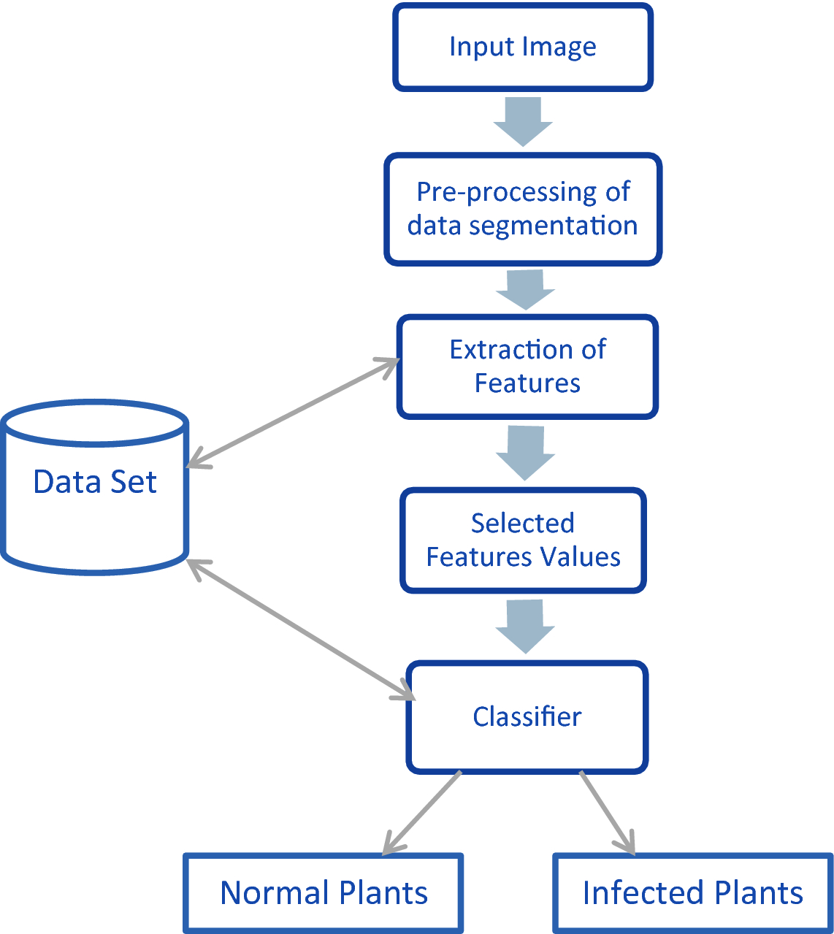
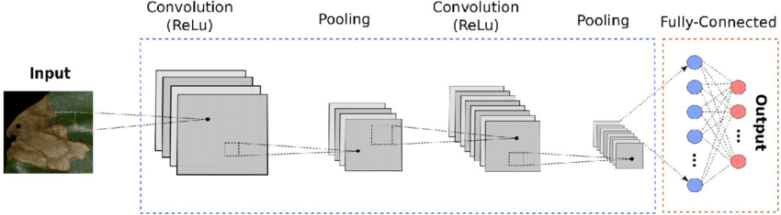
Design
Process Flow:

Slide 12
...Contd
Use Case Diagram:
Upload Dataset
Image Processing & Normalization
Build model
User
Upload Image & Predict
Accuracy & Graph
Exit

Slide 13
Implementation
The steps involved in this project are:
Image Acquisition:
This is the process of acquiring the images through a camera by going to the site or from other available sources such as image databases or online repositories.
Image Preprocessing:
To remove noise in an image, different pre-processing techniques are used. Clipping of leaf image is applied to extract the region of the image in which we are interested. The extracted plant leaf image is transferred to a digital system to remove the unnecessary areas. Some essential steps of preprocessing are: Resizing the image, Noise removal from the image, enhancement and smoothing of the image

Slide 14
…Contd
Image Segmentation:
This method of image processing is used to partition an image into significant components according to similar characteristics.
Feature Extraction:
It is a type of dimension reduction technique that effectively represent the useful part of the image. Various features such as texture, color, edges and morphology can be extracted for the detection of plant disease.
Classifiers:
Classifiers are used to identify and categorize the different diseases that occur on plant leaves based on obtained features. Several classifiers that have been used in earlier work to detect diseases in plants is Support Vector Machines (SVM).

Slide 15
Sample Code
Overall Sample Code:
# Importing necessary libraries
import tkinter
from tkinter import *
import matplotlib.pyplot as plt
import numpy as np
from keras.utils.np_utils import to_categorical
from keras.models import Sequential
from keras.layers.core import Dense,Activation,Dropout, Flatten
from keras.layers import Convolution2D
from keras.layers import MaxPooling2D
from sklearn.metrics import accuracy_score
import os
import cv2
import pickle

Slide 16
…Contd.,
#load dataset
def uploadDataset():
global X, Y
global filename
text.delete('1.0', END)
filename = filedialog.askdirectory(initialdir=".")
text.insert(END,'dataset loaded\n')
#image processing and normalization
X = np.load("model/myimg_data.txt.npy")
Y = np.load("model/myimg_label.txt.npy")
Y = to_categorical(Y)
X = np.asarray(X)
Y = np.asarray(Y)
X = X.astype('float32')
X = X/255

Slide 17
…Contd.,
#cnn model
model = Sequential() #resnet transfer learning code here
model.add(Convolution2D(32, 3, 3, input_shape = (64, 64, 3), activation = 'relu'))
model.add(MaxPooling2D(pool_size = (2, 2)))
model.add(Convolution2D(32, 3, 3, activation = 'relu'))
model.add(MaxPooling2D(pool_size = (2, 2)))
model.add(Flatten())
model.add(Dense(output_dim = 256, activation = 'relu'))
model.add(Dense(output_dim = 15, activation = 'softmax'))
model.compile(optimizer = 'adam', loss = 'categorical_crossentropy', metrics = ['accuracy'])
print(model.summary())
hist = model.fit(X, Y, batch_size=16, epochs=10, validation_split=0.2, shuffle=True, verbose=2)
#predict
filename = filedialog.askopenfilename(initialdir="testImages")
img = cv2.imread(filename)
img = cv2.resize(img, (64,64))
im2arr = np.array(img)

Slide 18
…Contd.,
im2arr = im2arr.reshape(1,64,64,3)
test = np.asarray(im2arr)
test = test.astype('float32')
test = test/255
preds = model.predict(test)
predict = np.argmax(preds)
if(predict==1):
cv2.putText(img, ' Given Leaf Pepper_bell and is Healthy', (10, 25), cv2.FONT_HERSHEY_SIMPLEX,0.7, (0, 255, 0), 2)
cv2.imshow('Crop Condition is healthy', img)
elif(predict==0):
cv2.putText(img, ' Given leaf is Pepper_bell and is Unhealthy', (10, 25), cv2.FONT_HERSHEY_SIMPLEX,0.7, (0, 255,0), 2)
cv2.imshow('Crop Condition is unhealthy', img)
elif(predict==2 or predict==4):
cv2.putText(img, ' Given leaf is Potato and is Unhealthy', (10, 25), cv2.FONT_HERSHEY_SIMPLEX,0.7, (0, 255, 0), 2)
cv2.imshow('Crop Condition is unhealthy', img)
elif predict==3:
cv2.putText(img, ' Given leaf is Potato and is Healthy', (10, 25), cv2.FONT_HERSHEY_SIMPLEX,0.7, (0, 255, 0), 2)
cv2.imshow('Crop Condition is healthy', img)

Slide 19
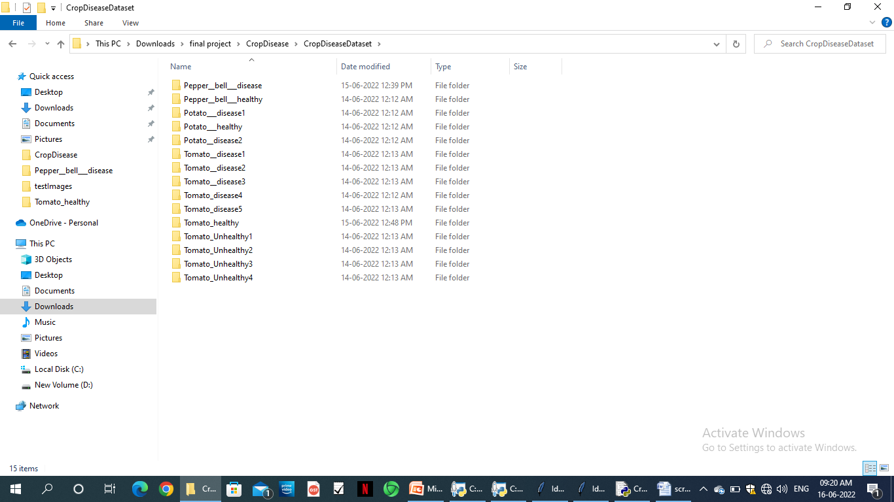
Screenshots
To implement this project we have used crop disease recognition dataset and this dataset saved inside ‘CropDiseaseDataset’ folder and below screen shot showing various type of healthy and unhealthy plants.

Slide 20
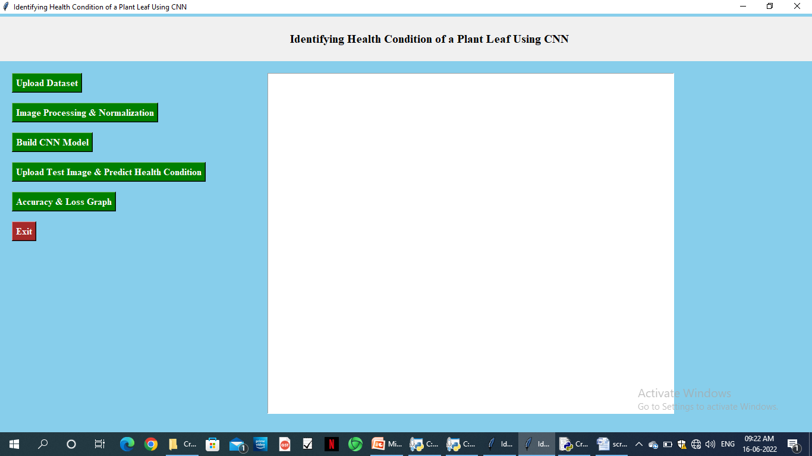
…Contd.,
To run project double click on ‘CropDisease.py’ file to get below screen

Slide 21
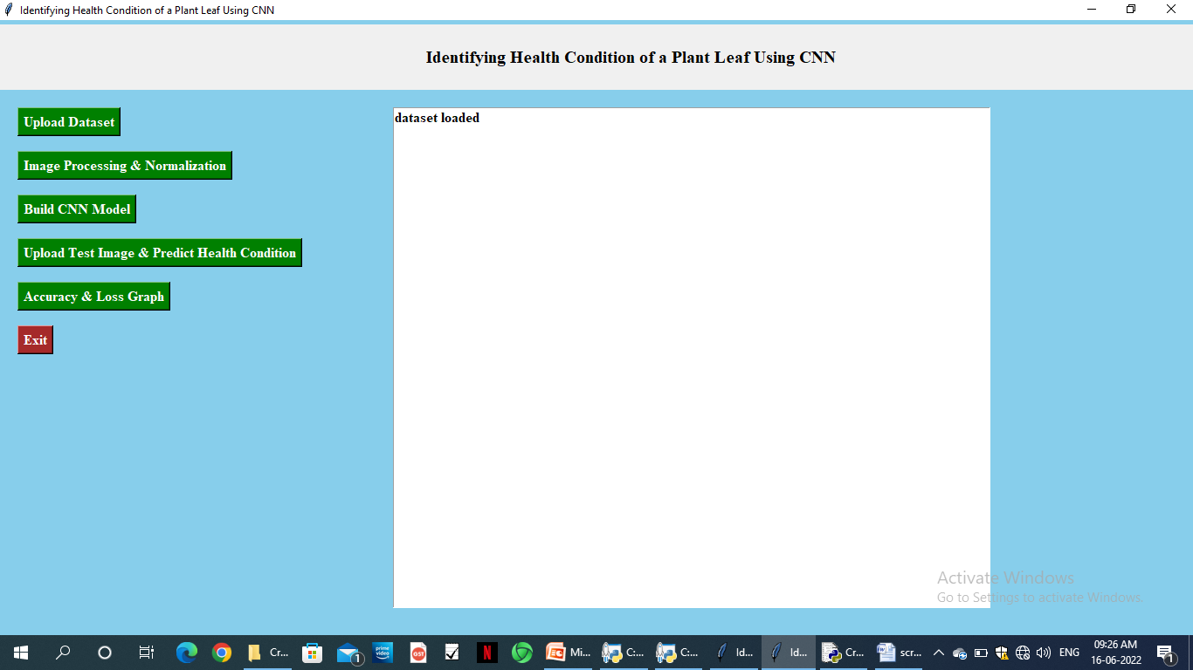
…Contd.,
Then click on ‘Upload Dataset’ to upload the dataset images. After
uploading the dataset we get the message ‘dataset loaded’ on the screen.

Slide 22
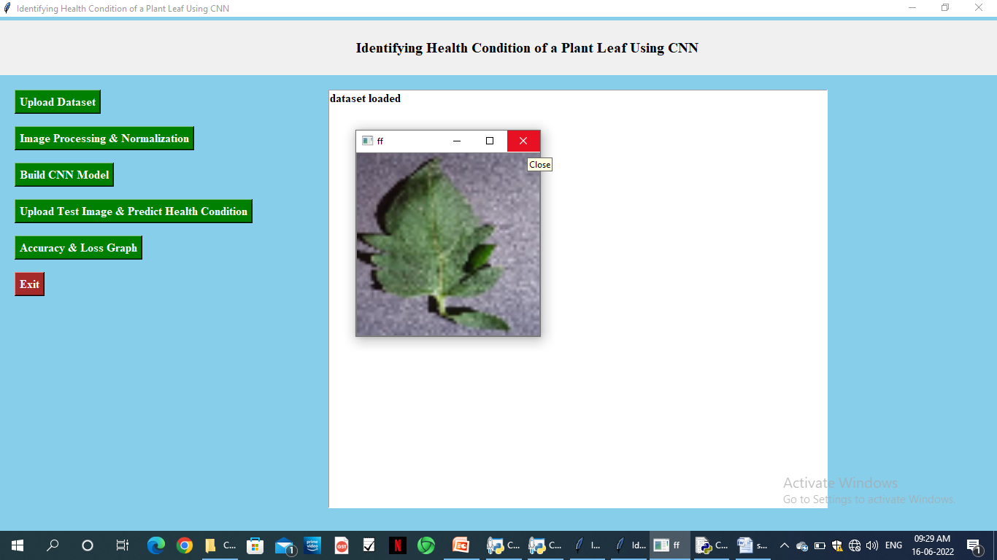
…Contd.,
Now click on ‘Image Processing & Normalization’ button to read all images and then process images to normalize by converting each image pixel value between 0 and 1.

Slide 23

…Contd.,
After applying normalization we are just displaying one random image from dataset to check whether images loaded and process properly or not and now you close above image to get below screen.

Slide 24
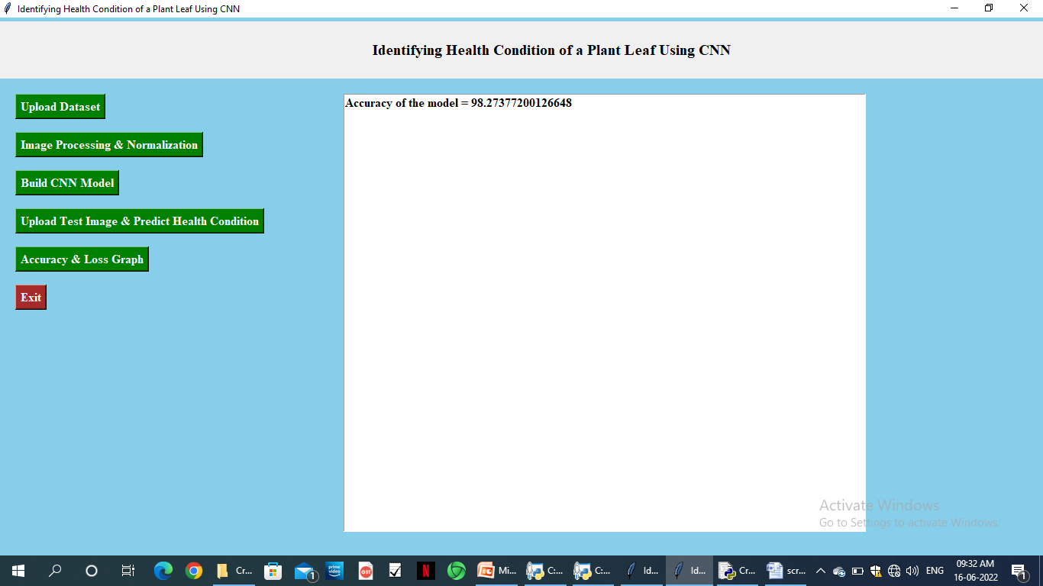
…Contd.,
All images process successfully and now dataset images are ready and now click on ‘Build CNN Model’ button to build CNN model

Slide 25
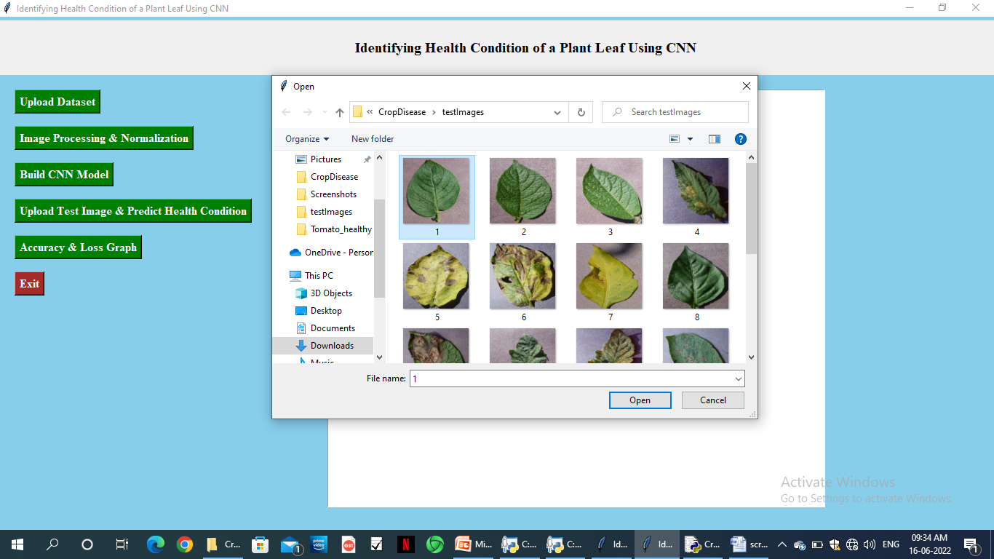
…Contd.,
Now model is ready and now click on ‘Upload Test Image & Predict Health Condition’ button to upload any test image and then application will predict disease or healthy from that image.

Slide 26
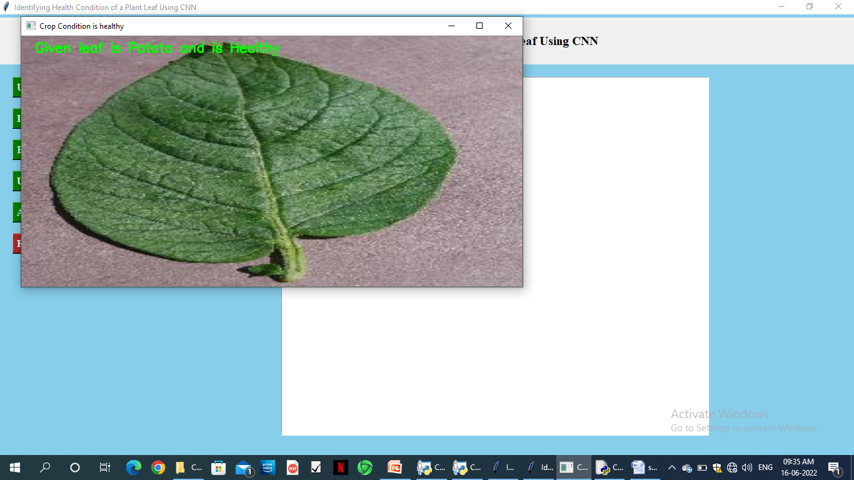
…Contd.,
Selecting and uploading ‘1.JPG’ image file and then click on ‘Open’ button to get below prediction result.

Slide 27
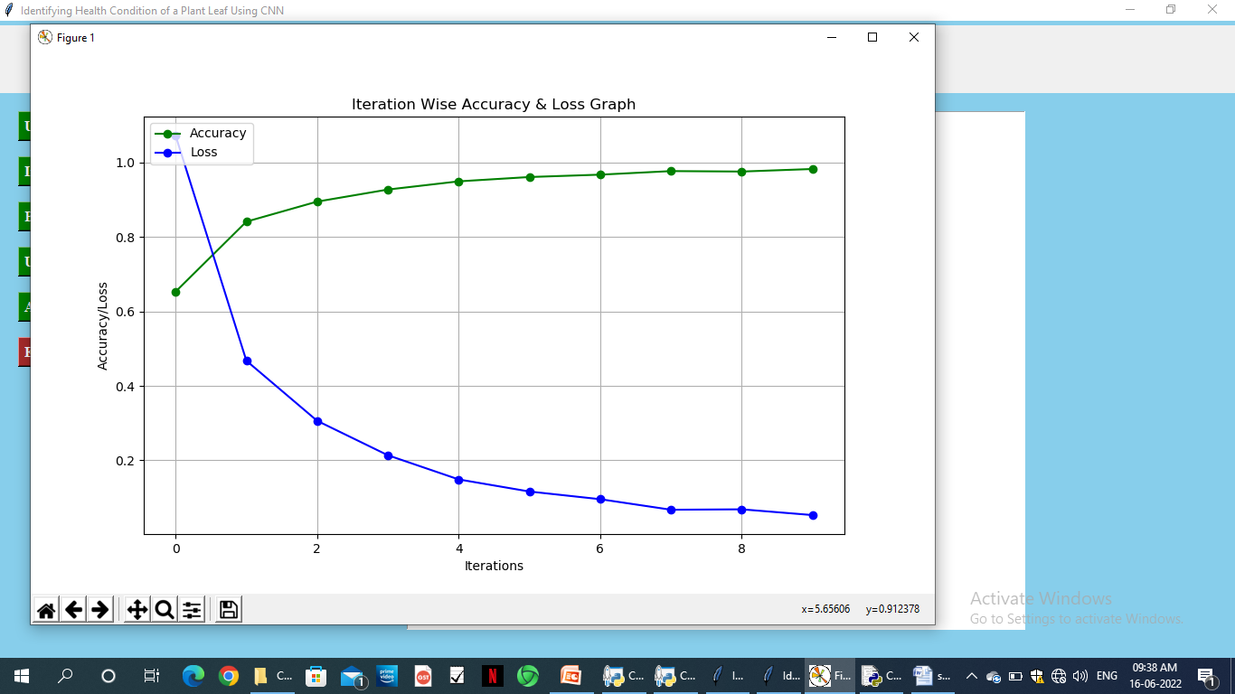
…Contd.,
Now click on ‘Accuracy & Loss Graph’ button to get below graph

Slide 28
Conclusion
To prevent losses, small hold farmers are dependent on a timely and accurate crop disease diagnosis. In this project, a pre-trained convolutional neural network is built. The final result was a plant health condition detection Python application.
Overall, this study is conclusive in demonstrating how CNNs may be applied to empower small-holder farmers in their fight against plant disease. In the future, work should be focused on diversifying training datasets and also in testing similar applications in real life situations. Without such developments, the struggle against plant disease will continue.

Slide 29
References
[1]. Mr.V Suresh, D Gopinath, M Hemavarthini, K Jayanthan, Mohana Krishnan,
“Plant Disease Detection using Image Processing”, International Journal of
Engineering Research and & Technology(IJERT), ISSN: 2278-0181, Vol.9
Issue 03, March-2020
[2].Vagisha Sharma, Amandeep Verma, Neelam Goel , “Classification
Techniques for Plant Disease Detection”, International Journal of Recent
Technology & Engineering(IJRTE), ISSN: 2277-3878, Volume-8 Issue 6,
March 2020.
[3]. Dr. L. Malathi 1, P. Yogashree 2, Thamaraiselvi 3, “Automatic Detection and
Classification Of Plant Leaf Disease Using Deep Convolutional Neural
Network”, Journal of Xi’an University of Architecture and Technology”, ISSP No:
1006-7930.
[4]. Dataset link: https://www.kaggle.com/datasets/emmarex/plantdisease

Slide 30
Thank You!!!

